Slide 1

Data Engineering Pipeline for Insurance Price Prediction

Slide 2
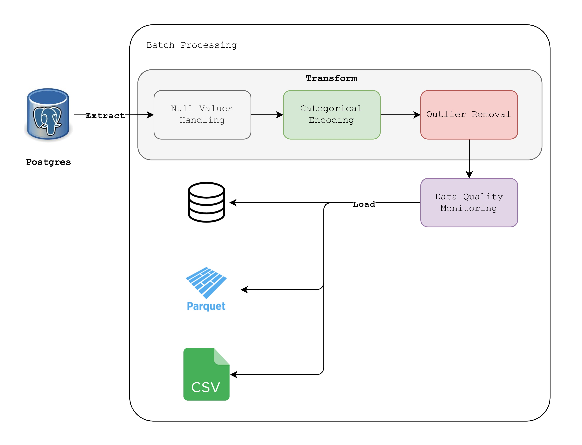
Pipeline Design
Data Pipeline Overview
The Data pipe line extracts, transforms and loads raw insurance data
The main aim is to maintain data quality and to establish a structured storage system which enables analytical and modeling functions.
2. Pipeline Type Justification
Batch Processing: Suitable for periodic updates (daily/weekly ingestion).
Justification: Insurance data is structured and doesn't require real-time updates.
Alternative: Streaming pipelines could be used for real-time analytics.
3. Data Format Selection
Parquet: Chosen for efficient storage and fast querying.
CSV: Used for ease of access.
Justification: Parquet provides better compression and performance.
Notes:
This slide presents the overall data pipeline used for processing raw insurance data.
The process begins with extracting data from PostgreSQL.
The data then undergoes transformations, including handling missing values, categorical encoding, and outlier removal.
The final processed data is stored in multiple formats for different use cases:
PostgreSQL for structured database storage.
Parquet for optimized analytics performance.
CSV for accessibility and ease of use.
Since insurance data doesn’t require real-time updates, a batch processing pipeline was chosen.
The justification for Parquet as a format is its efficiency in storage and querying.

Slide 3

Data quality
1. Identified Data Quality Issues
Missing Values: No missing values were detected in the dataset.
Duplicate Entries: No duplicate records were found.
Outliers: 2,217 outlier values were detected in the ‘charges’ column based on the interquartile range (IQR) method.
Categorical Data Fields: Issues with inconsistent values, typos, and mixed-case entries in fields like gender, region, smoker, and occupation.
2. Data Validation & Monitoring
Missing Values: Missing values we found for parameters ‘medical_history’ and ‘family_medical_history’.
Duplicate Removal: No duplicates detected, but monitoring for future inconsistencies is necessary.
Outlier Detection: Outliers in the charge's column should be analyzed and handled
Categorical Data Cleaning: Standardizing categorical values (e.g., ensuring consistent casing and correcting typos) to maintain uniformity.
3. Schema Evolution & Data Drift Detection
Schema Changes: Monitor column structure using database constraints.
Data Drift: Regularly comparing statistical summaries over time.
Monitoring Approach: Automated validation rules in SQL or Python scripts.
Pydantic for Schema Evolution: Utilizing Pydantic for data validation and schema evolution to enforce structure and type consistency in incoming data.
Notes:
This slide outlines the key data quality challenges and how they are handled in our pipeline.
Missing values were found in columns medical_history and family_medical_history. This null values can be replaced by “Unknown/Not Provided”
Outliers were identified, particularly in the charges column, using statistical methods like the IQR.
Categorical data inconsistencies were found, such as typos or inconsistent casing in columns like gender, region, and smoker.
To address these issues, we implemented data validation and monitoring, ensuring clean and consistent data.
Schema evolution and data drift detection are crucial in long-term data management. We use Pydantic for schema validation and enforce consistency in incoming data.
Future enhancements may include automated anomaly detection and real-time validation mechanisms.

Slide 4
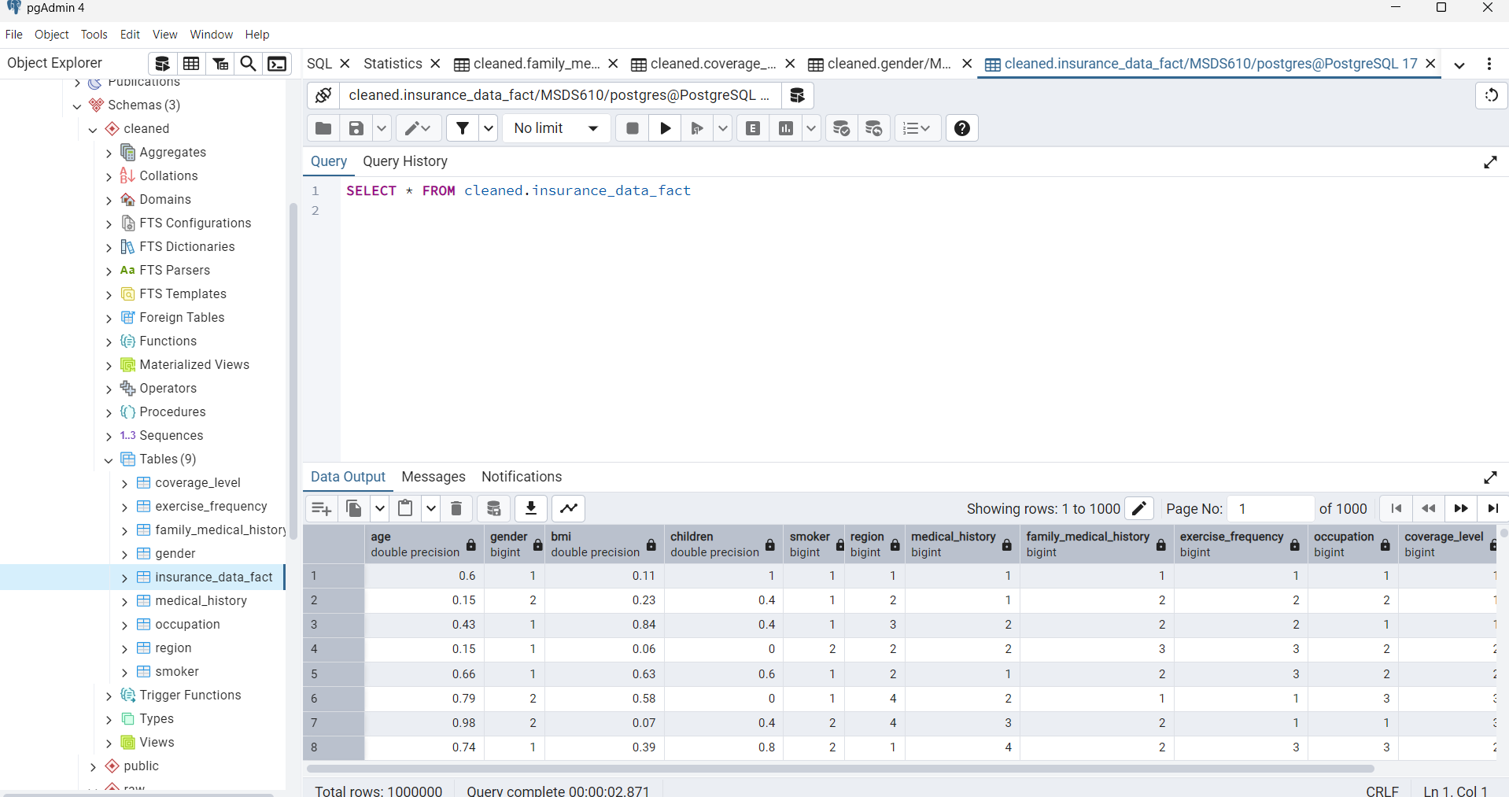
Notes:
In this pipeline, categorical encoding, missing value handling, and data normalization were implemented using the scikit-learn library. These steps ensured data consistency and maintained data integrity.
Following the preprocessing stage, a star schema database model was designed and created. The schema consists of a fact table containing measurable data and dimension tables storing categorical attributes. This structure enhances query performance, simplifies data organization, and optimizes analytics workflows.

